Slide 1


Slide 2
Agenda
Software Required
Software Components Diagram
Java SE - JDK vs JRE
Java History
Java Technologies
Computer Memory Types
Java Variables
Java Data Types
JAVA TRAINING www.busyqa.com/bigdata |www.busyqa.com/online-automation

Slide 3
Software Required
JDK 17 - Java Development Kit (Java Platform).
Java Virtual Machine (JVM)
Java Libraries (Java Application Programming Interface API)
Java Language (Implements the Java Language Specification - JLS)
Developer Tools (For instance, the Java compiler)
Eclipse IDE - Integrated Development Environment (Code Editor).
Git Client - Version control system client.
Allow us to connect to Git providers such GitHub.
For Windows users only.
Notes:
‹#›

Slide 4
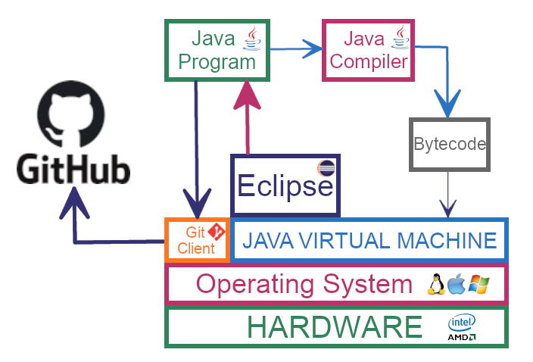
Software Components Diagram
Notes:
‹#›

Slide 5
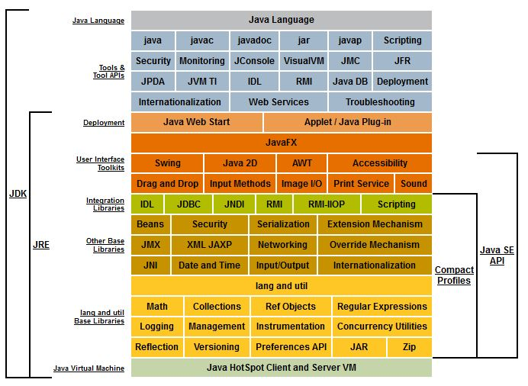
Java SE - JDK vs JRE
Notes:
JRE stands for Java Runtime Environment.
It is installed to run Java programs only as it doesn’t include the developer tools.
‹#›

Slide 6

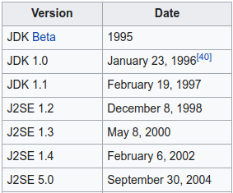
Java History
In 1991, James Gosling and his team wanted a programming language for their new projects.
First they thought of using C and C++, but both were system dependant so they decided to create a new system independent programming language.
This language was initially called Oak. Since this name was registered by some other company, later it was renamed as Java.
Java WORA capability (Write Once Run Anywhere) makes it able to run on any Java-enabled system without any adjustment.
Notes:
Java was publicly released in 1995.
‹#›

Slide 7
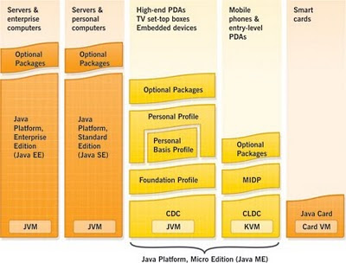
Java Technologies
Java SE (Standard Edition)
Java EE / Jakarta EE (Enterprise Edition)
Java ME (Micro Edition).
Notes:
Jakarta EE, formerly Java Platform, Enterprise Edition (Java EE) .
Java EE was maintained by Oracle under the Java Community Process. On September 12, 2017, Oracle Corporation announced that it would submit Java EE to the Eclipse Foundation. The Eclipse top-level project has been named Eclipse Enterprise for Java (EE4J). The Eclipse Foundation could not agree with Oracle over the use of javax and Java trademarks. Oracle owns the trademark for the name "Java" and the platform was renamed from Java EE to Jakarta EE. The name refers to the largest city on the island of Java and also the capital of Indonesia, Jakarta. The name should not be confused with the former Jakarta Project which fostered a number of current and former Java projects at the Apache Software Foundation.

Slide 8
Computer Memory Types
Notes:
Jakarta EE, formerly Java Platform, Enterprise Edition (Java EE) .
Java EE was maintained by Oracle under the Java Community Process. On September 12, 2017, Oracle Corporation announced that it would submit Java EE to the Eclipse Foundation. The Eclipse top-level project has been named Eclipse Enterprise for Java (EE4J). The Eclipse Foundation could not agree with Oracle over the use of javax and Java trademarks. Oracle owns the trademark for the name "Java" and the platform was renamed from Java EE to Jakarta EE. The name refers to the largest city on the island of Java and also the capital of Indonesia, Jakarta. The name should not be confused with the former Jakarta Project which fostered a number of current and former Java projects at the Apache Software Foundation.

Slide 9
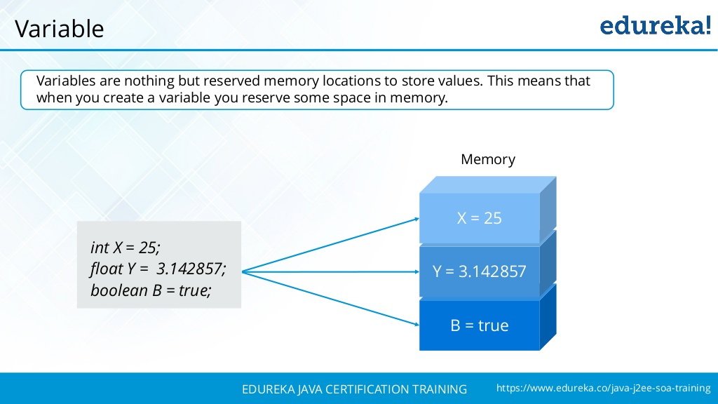
Java Variables
Notes:
‹#›

Slide 10

Java Data Types
Notes:
‹#›

Slide 11
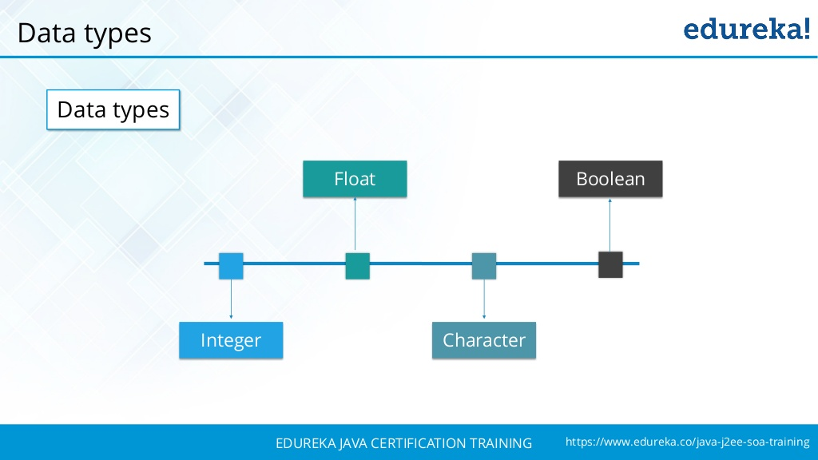
Java Data Types
Notes:
‹#›

Slide 12
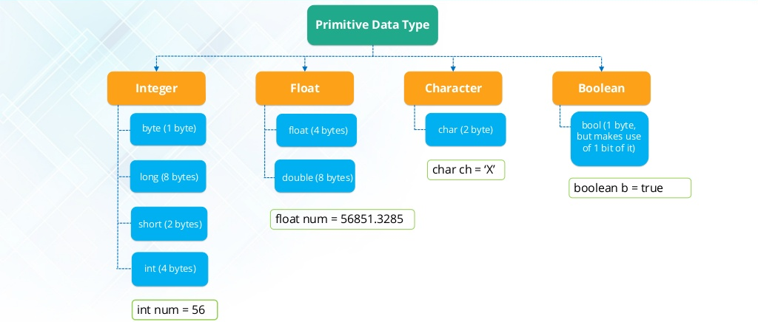
Java Data Types
Notes:
‹#›

Slide 13
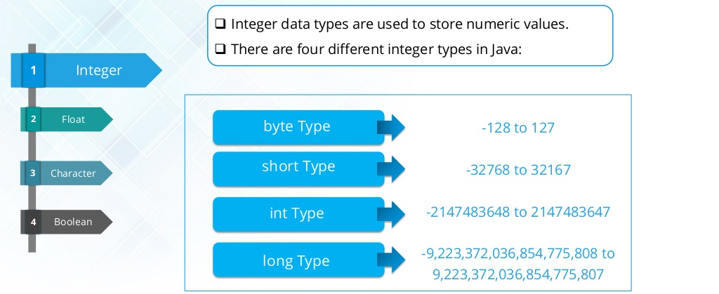
Numeric Data Type
Notes:
‹#›

Slide 14
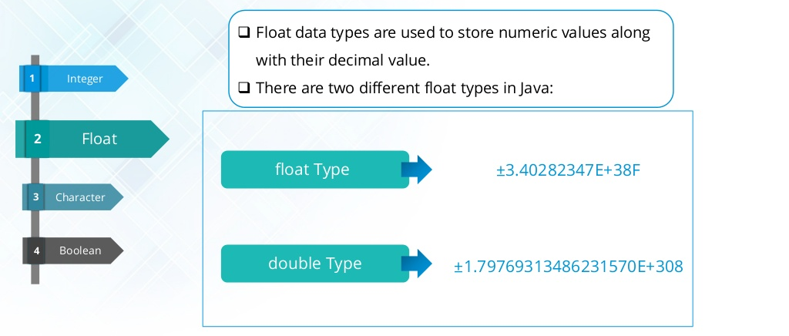
Float Data Type
Notes:
‹#›

Slide 15
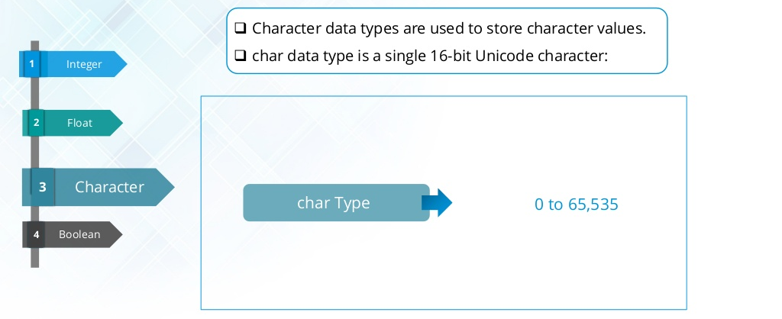
Character Data Type
Notes:
‹#›

Slide 16


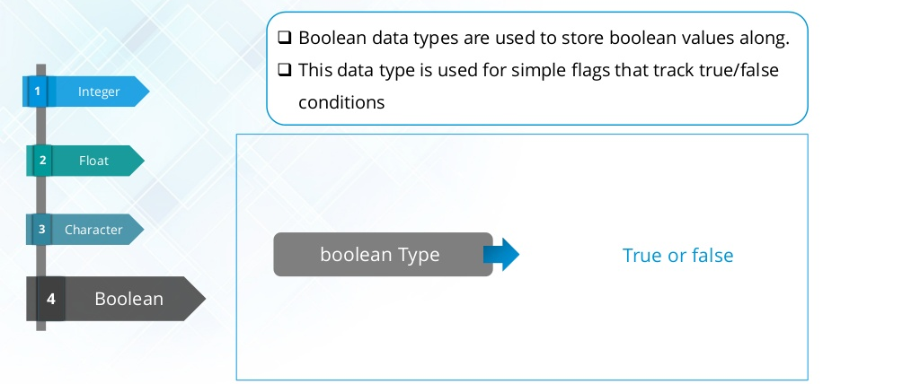
Boolean Data Type
Notes:
‹#›

Slide 17
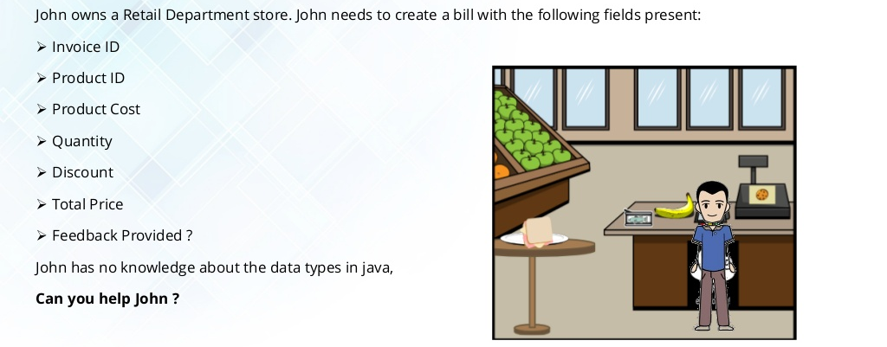
Java Data Types
Notes:
‹#›

Slide 18
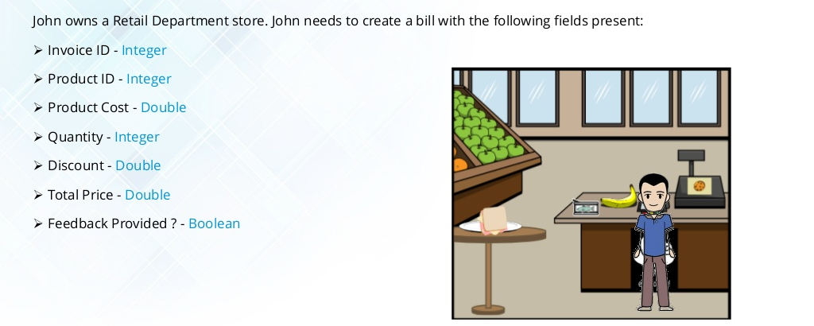
Java Data Types
Notes:
‹#›

Slide 19
Agenda
Operators
Arithmetic
Relational
Unary
Logical
Conditional Statements (if, if-else, switch)
Loops (while, do-while, for and for-each)
Break
Continue
Java Arrays
Java Strings

Slide 20
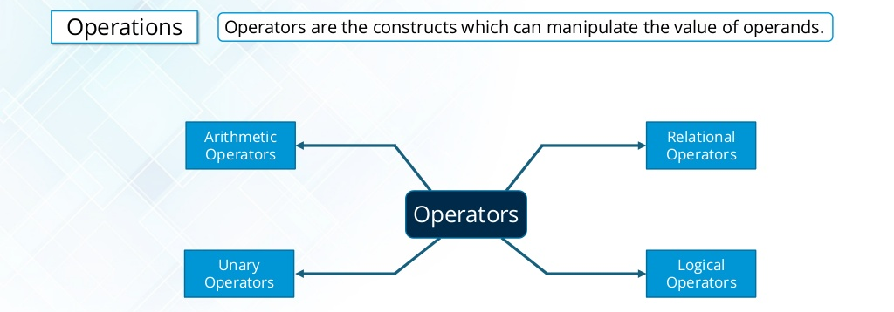
Data Operations
Notes:
Operators are used to perform operations on variables and values.
‹#›

Slide 21
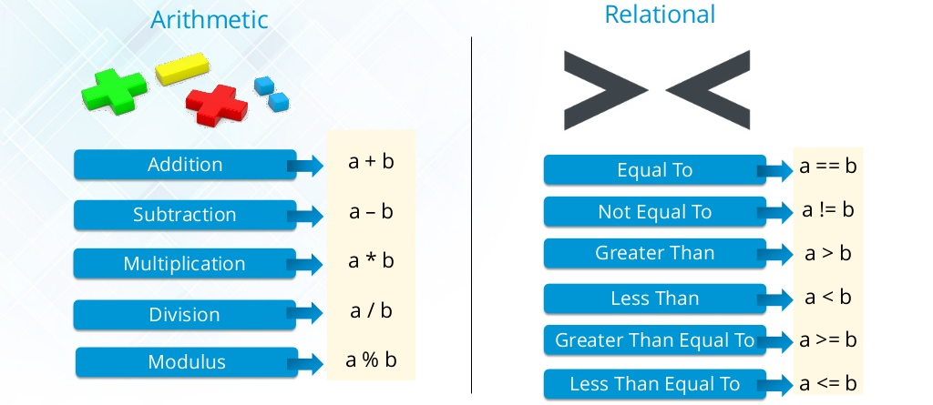
Arithmetic and Relational Operators
Notes:
‹#›

Slide 22
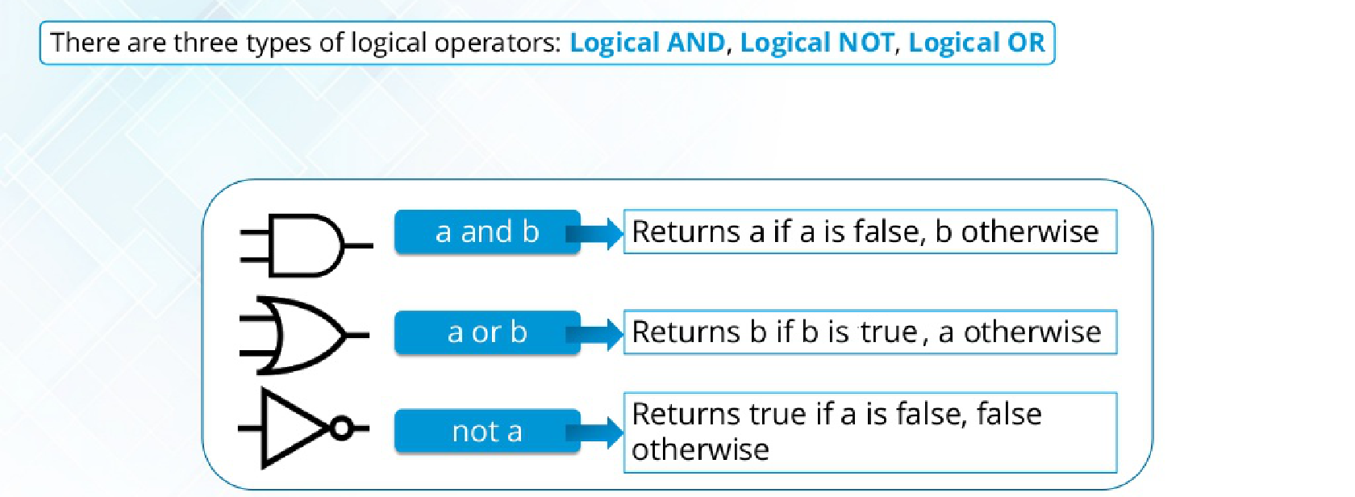
Logical Operators
Notes:
‹#›

Slide 23
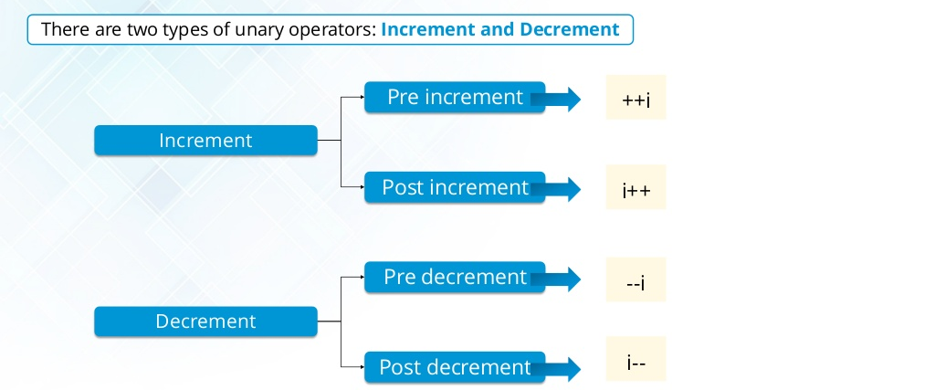
Unary Operators
Notes:
‹#›

Slide 24
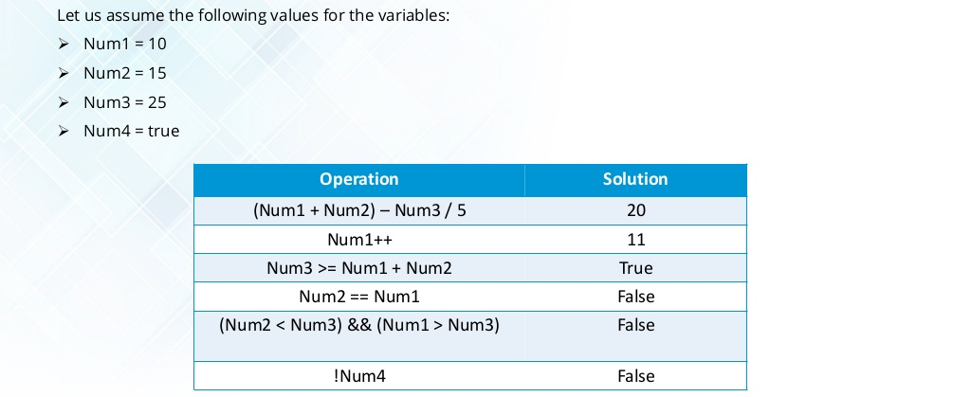
Data Operations
Notes:
‹#›

Slide 25
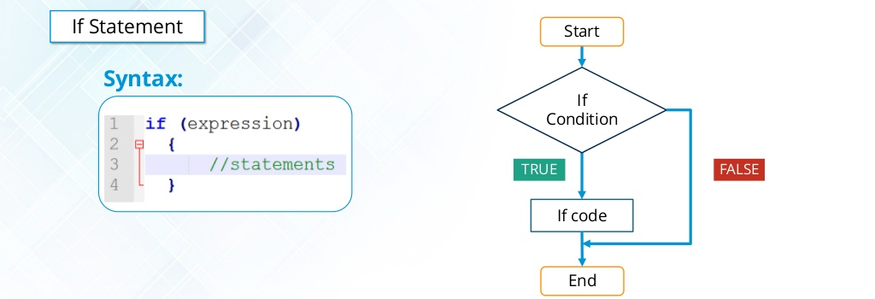
Conditional Statements
Notes:
‹#›

Slide 26
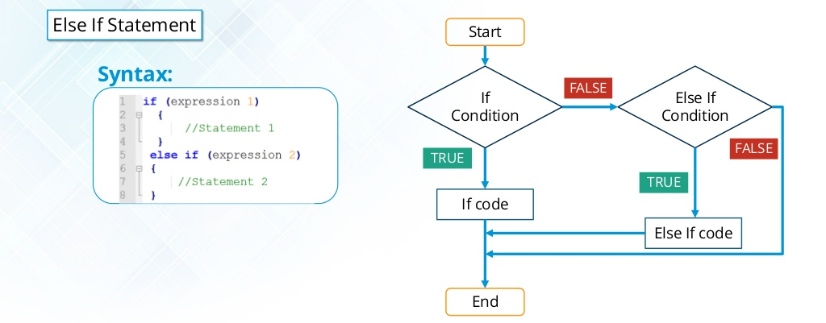
Conditional Statements
Notes:
‹#›

Slide 27
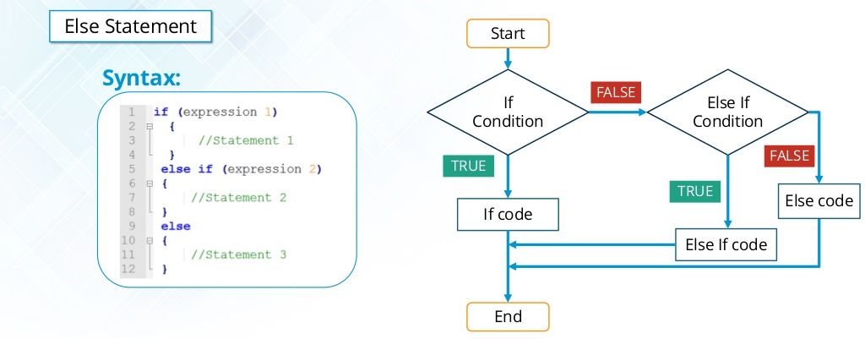
Conditional Statements
Notes:
‹#›

Slide 28
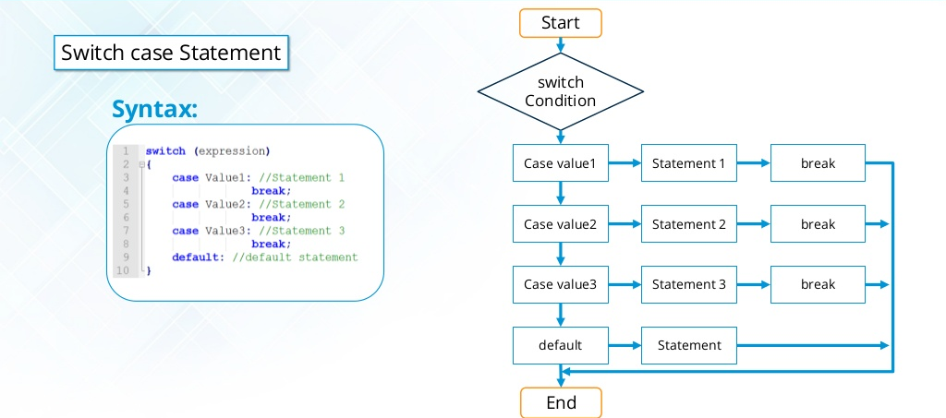
Conditional Statements
Notes:
‹#›

Slide 29
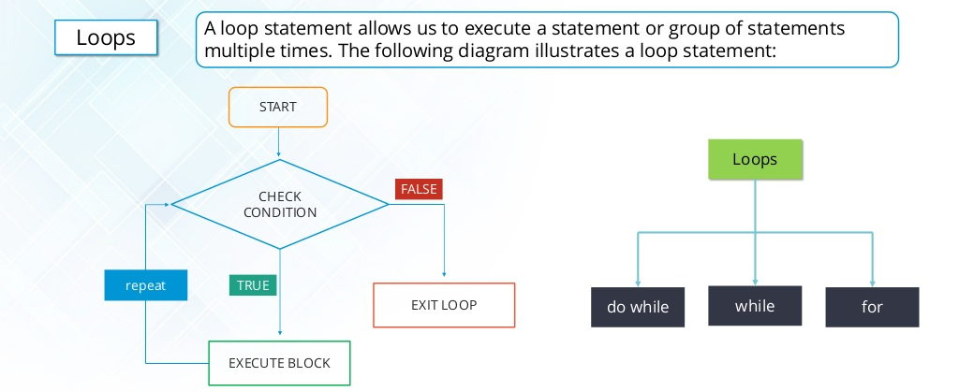
Loops
Notes:
‹#›

Slide 30
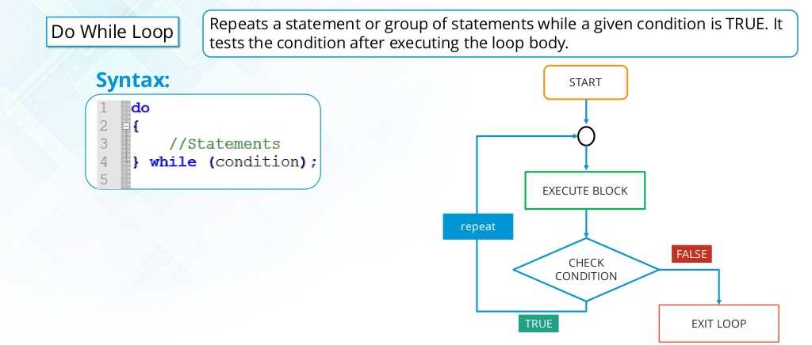
Do While Loop
Notes:
‹#›

Slide 31
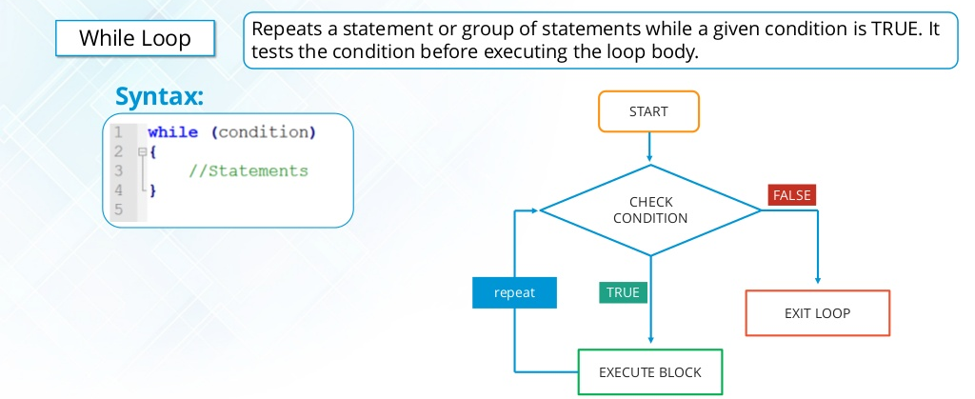
While Loop
Notes:
‹#›

Slide 32
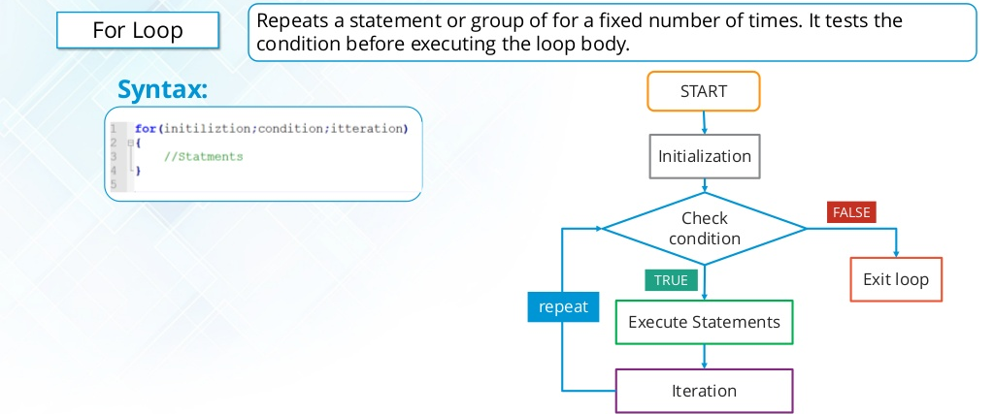
For Loop
Notes:
‹#›

Slide 33
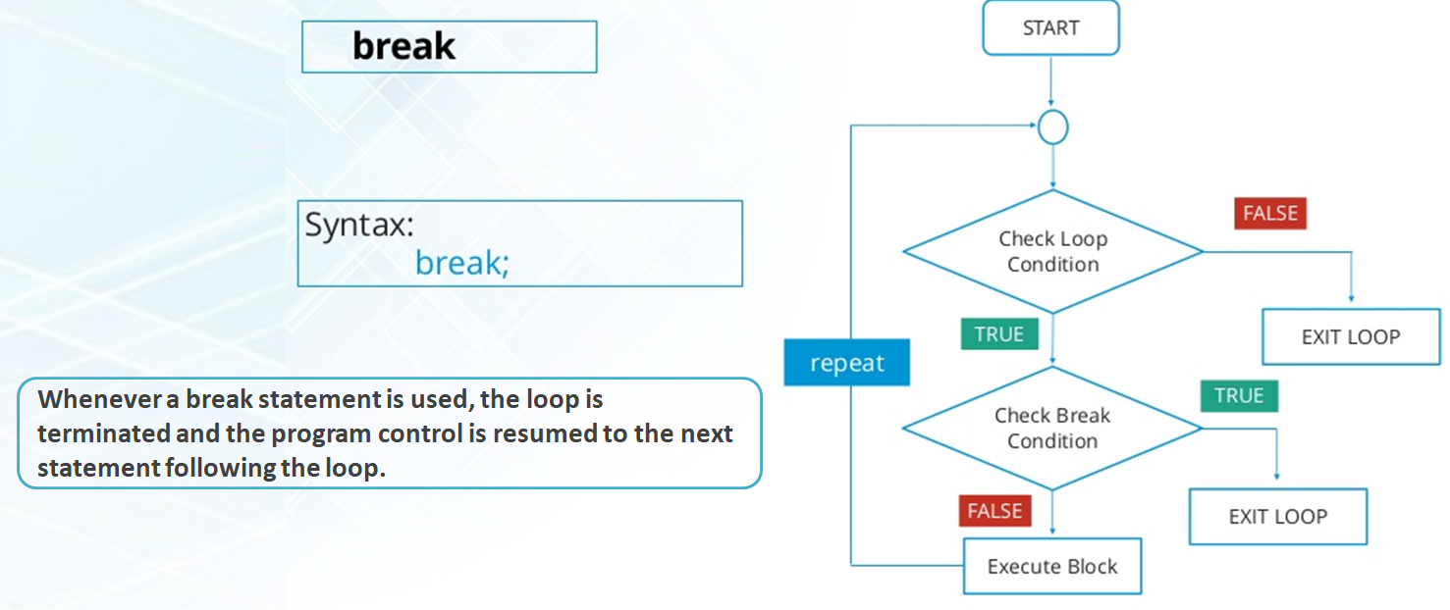

Break
Notes:
‹#›

Slide 34
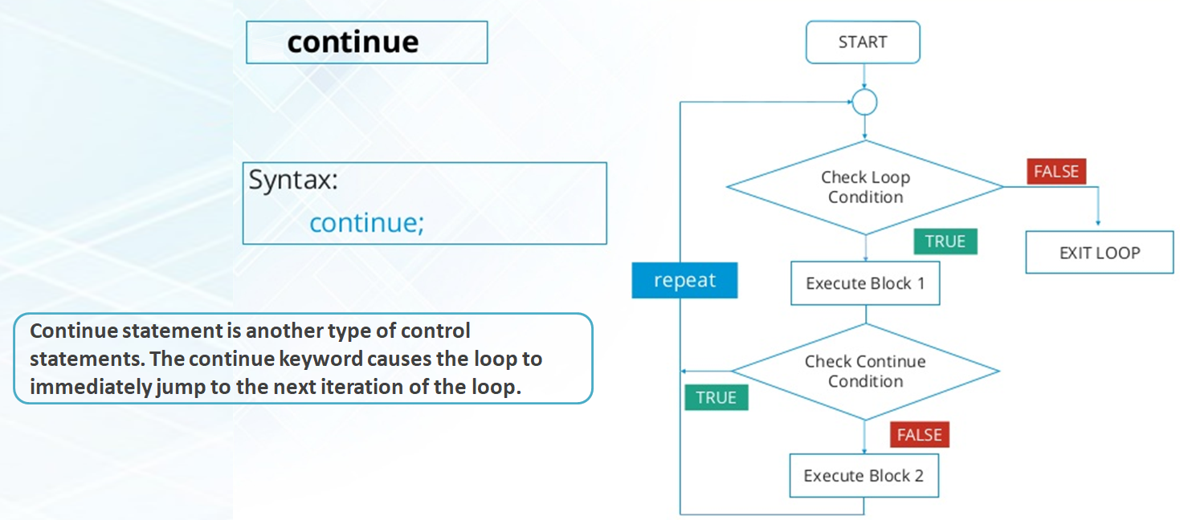
Continue
Notes:
‹#›

Slide 35
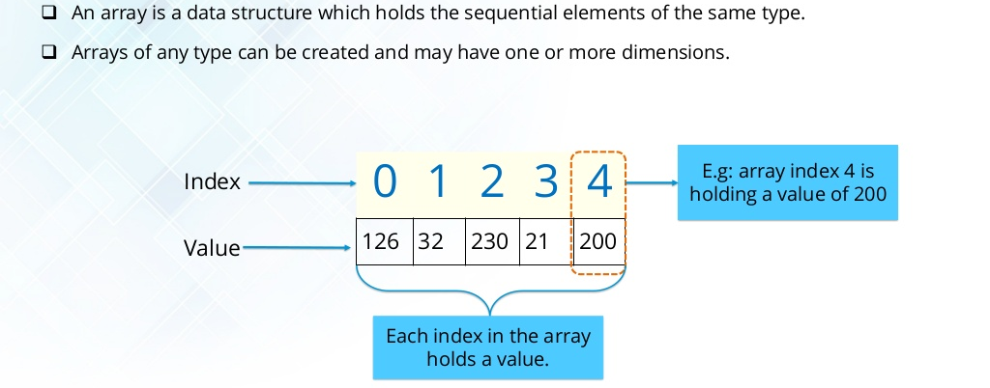
Java Arrays
Notes:
‹#›

Slide 36
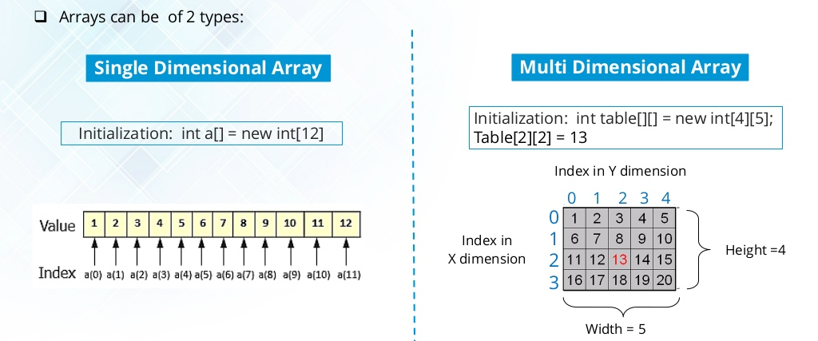
Java Arrays
Notes:
‹#›

Slide 37
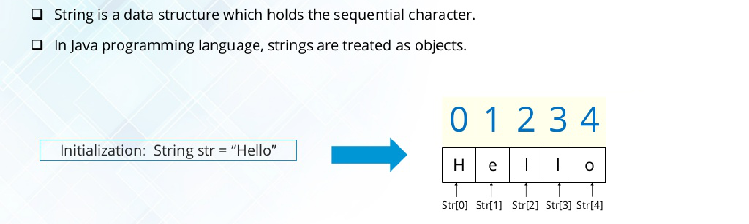
Java Strings
Notes:
‹#›

Slide 38
Operations on Strings
length(): It returns the total number of characters of a string.
String str = “Welcome”
str.length()
7
concat() : It concatenates two strings. It appends another string to the string.
String str1 = “Welcome”
String str2 = “ To Java”
str1.concat(str2)
Welcome To Java
trim() : Removes the leading and trailing white spaces of the string.
String str = “ Welcome ”
str.trim()
Welcome

Slide 39
Operations on Strings
charAt(): Returns the char value at the given index number. The index number starts from 0.
String str = “Welcome”
str.charAt(3)
c
contains() : Searches for a sequence of characters within a string.
String str = “Welcome”
str.contains(“Wel”)
true
equals() : Compares the content of two strings.
String str = “Welcome”
str.equals(“Welcome”)
true
String str = “Welcome”
str.equals(“welcome”)
false

Slide 40
Operations on Strings
equalsIgnoreCase() : Compares the content of two strings but it does not check the case.
String str = “Welcome”
str.equalsIgnoreCase(“Welcome”)
true
String str = “Welcome”
str.equalsIgnoreCase(“welcome”)
true
replace(): Replace a character or a substring within a string. There are two replace methods.
String str = “Welcome”
str.replace(’e’, ’a’)
Walcoma
String str = “Welcome To Java”
str.replace(“Java”, ”Selenium”)
Welcome To Selenium

Slide 41
Operations on Strings
substring() : Returns a substring based on starting and ending indexes.
Starting Index
0 | 1 | 2 | 3 | 4 | 5 | 6
W | E | L | C | O | M | E
1 | 2 | 3 | 4 | 5 | 6 | 7
Ending Index
String str = “Welcome”
str.substring(1,3)
el
String str = “Welcome”
str.substring(0,4)
Welc
String str = “Welcome”
str.substring(2,4)
lc

Slide 42
Operations on Strings
toLowerCase(): returns the string in lowercase letters.
String str = “WELCOME”
str.toLowerCase()
welcome
toUpperCase(): returns the string in uppercase letters.
String str = “welcome”
str.toUpperCase()
WELCOME

Slide 43
Agenda
Classes and Objects.
Methods and Constructors.
Objects Initialization.
Java main() method.
Object Oriented Programming (OOP) Concepts.
The this keyword.
Overloading in Java.
The static keyword.
Inheritance in Java.
Overriding in Java.

Slide 44
Agenda
The super keyword.
The final keyword.
Java Interfaces.
Java Packages.
Access modifiers.

Slide 45
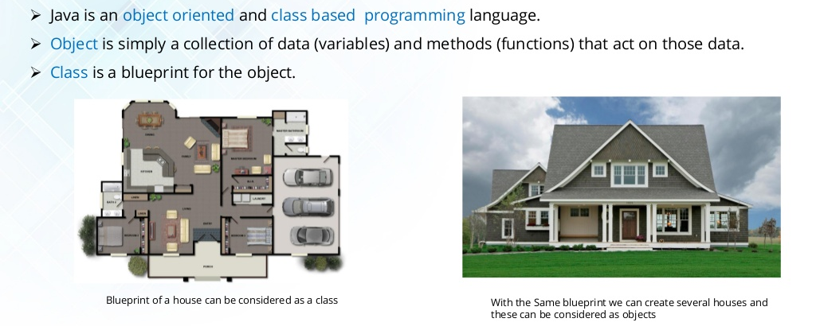
Classes and Objects
Notes:
– OOP is a paradigm where everything is an object.
– A paradigm is way of how we see or understand things.
– In OOP, we translate real-life entities into objects.
– For example let's say we need to build a computer software that handles the company employee's information
We would need to create an object Employee that contains only the relevant aspects for the computer system
of the real-life entity called Employee.
‹#›

Slide 46
Classes and Objects
Object1
class Employee {
int eid;
String ename;
double sal;
String job;
void display() {
System.out.println(eid);
System.out.println(ename);
System.out.println(sal);
System.out.println(job);
}
void bonus(){
System.out.println((sal *10) /100);
}
}
Employee emp1 = new Employee();
emp1.eid=1020;
emp1.ename="John";
emp1.sal=80000;
emp1.job="Manager";
emp1.display();
Variables
Object2
Class
Employee emp2=new Employee();
emp2.eid=1021;
emp2.ename="David";
emp2.sal=50000;
emp2.job="Tech Assistant";
emp2.display();
Methods
Notes:
-- A class has three types of elements.
-- Attributes
-- Constructors (Default, and Parameterized)
-- Methods (With or without parameters, and with or without return statement)

Slide 47
Java Methods
A method is a block of code which is referred to by name and can be called (invoked) at any point in a program simply by utilizing the method's name.
A method as a subprogram that acts on data and often returns a value.
 | Parameter(s) | Returned Value
Case1 | ❒ | ❒
Case2 | ❒ | 
Case3 |  | ❒
Case4 |  | 

Slide 48
Java Constructors
A constructor is a type of method used to initialize an object.
The constructor is invoked at the time of the object creation.
The rules for creating a constructor in Java:
The constructor name must be the same as its class name.
The constructor must have no explicit return type.
There are two types of constructors.
Default Constructor
Parameterized

Slide 49
Methods vs Constructors
The method name can be any string.
The method can return a value.
We call methods explicitly.
Method
The constructor name must be the same as class name.
The constructor doesn't return a value.
Java automatically invokes the constructor when creating an object .
Constructor

Slide 50
Object Initialization
There are three ways to initialize objects in Java.
By reference variable
By method
By constructor

Slide 51
Object Initialization
Object initialization through reference variable.
Student.java
TestStudent.java
class Student{
int id;
String name;
}
class TestStudent{
public static void main(String args[]){
Student s = new Student();
s.id = 101;
s.name = “John”;
System.out.println(s.id + “ ” + s.name);
}
}

Slide 52
Object Initialization
Object initialization through a method.
Student.java
TestStudent.java
class Student {
int id;
String name;
void insertRecord(int i, String n){
id = i;
name = n;
}
void displayInformation(){
System.out.println(id + “ ” + name);
}
}
class TestStudent{
public static void main(String args[]){
Student s1 = new Student();
Student s2 = new Student();
s1.insertRecord(111,"John");
s2.insertRecord(222,"Joe");
s1.displayInformation();
s2.displayInformation();
}
}

Slide 53
Object Initialization
Object initialization through a constructor.
Student.java
TestStudent.java
class Student{
int id;
String name;
Student(int i, String n){
id = r;
name = n;
}
void displayInformation(){
System.out.println(id + “ ” + name);
}
}
class TestStudent{
public static void main(String args[]){
Student s1 = new Student(111,”John”);
Student s2 = new Student(222,”Joe”);
s1.displayInformation();
s2.displayInformation();
}
}

Slide 54
The main() Method
main() method within class.
Student.java
class Student{
int id = 101; /* attribute or instance variable */
String name = “John”;
public static void main(String args[]){
Student s = new Student(); /* create an object of Student class */
System.out.println(s.id); /* access an attribute through reference */
System.out.println(s.name);
}
}

Slide 55
The main() Method
main() method outside class
In real world software development we create classes and use them from another classes.
Student.java
TestStudent.java
class Student {
int id = 101;
String name = “John”;
}
class TestStudent{
public static void main(String args[]){
Student s = new Student();
System.out.println(s.id);
System.out.println(s.name);
}
}

Slide 56
OOP Concepts
There are four main Object Oriented Programming (OOP) concepts in Java.
Inheritance
Encapsulation
Polymorphism
Data Abstraction

Slide 57
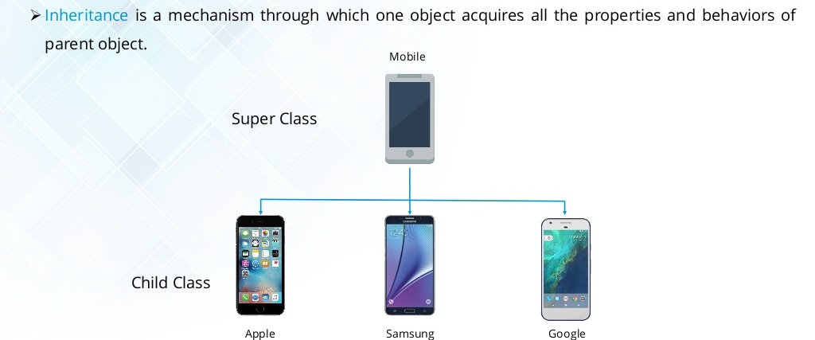
Inheritance
Notes:
‹#›

Slide 58
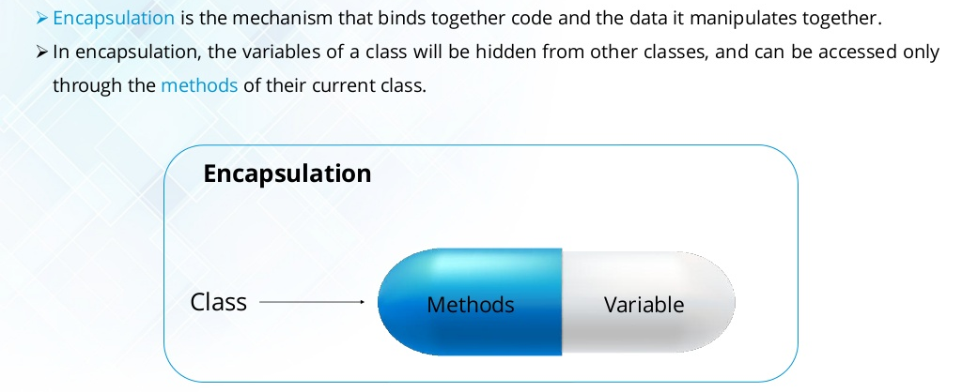
Encapsulation
Notes:
‹#›

Slide 59
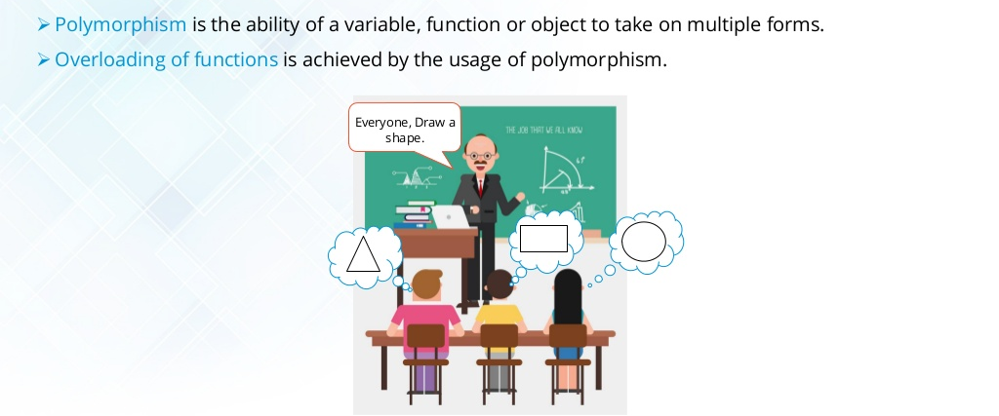
Polymorphism
Notes:
‹#›

Slide 60
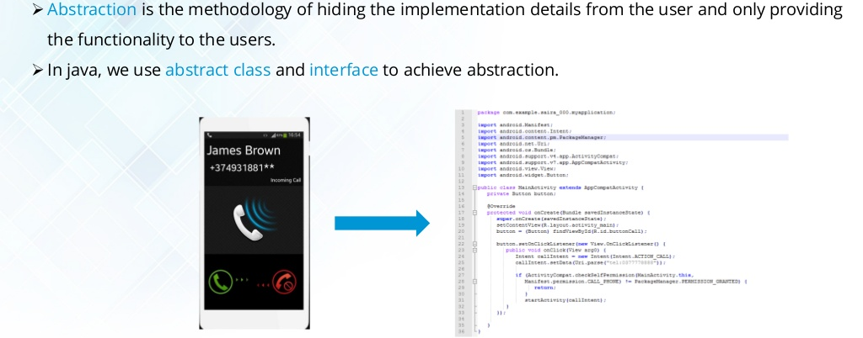
Data Abstraction
Notes:
‹#›

Slide 61
The this keyword
The this keyword is used to refer an object’s instance variable. This keyword resolves the problem of ambiguity between the instance variables and parameters.
public class Calculator {
int a, b;
void add(int a, int b){
a = a;
b = b;
}
void display(){
System.out.println(a);
System.out.println(b);
}
public static void main(String[] args){
Calculator cal = new Calculator();
cal.add(10, 20);
cal.display();
}
}
public class Calculator {
int a, b;
void add(int a, int b){
this.a = a;
this.b = b;
}
void display(){
System.out.println(a);
System.out.println(b);
}
public static void main(String[] args){
Calculator cal = new Calculator();
cal.add(10, 20);
cal.display();
}
}
Output:
0
0
Output:
10
20

Slide 62
Overloading in Java
Overloading is a form of Polymorphism, which is an Object-Oriented Programming (OOP) concept.
Java supports methods and constructors overloading.
Overloading is a situation wherein a class, two or more methods or constructors, have the same name but different parameters.
Method overloading can be done in two ways:
By changing the parameters’ data types.
By changing the number of parameters.

Slide 63
Overloading in Java
10, 20
add(int x, int y)
add(int x, int y, int z)
add(double x, double y)
add(double x, double y, double z)
add (int x, double y)
add (double y, int x)
10, 20, 30
10.5, 20.0
10.5, 20.0, 30.5
10, 20.5
20.5, 10

Slide 64
Can we overload the main() method?
Yes. You can have any number of main methods in a class by method overloading. But the JVM calls only the main() method that takes the string array as a parameter.
class TestOverloading{
public static void main(String[] args){
System.out.println("main with String[]");
}
public static void main(String args){
System.out.println("main with String");
}
public static void main(){
System.out.println("main without args");
}
}
‹#›

Slide 65
The static keyword
The static keyword is used for memory management mainly.
We can apply static keyword on variables and methods only.

Slide 66
The static keyword
Employee
int empno;
String ename;
int deptno;
void bonus()
emp1
emp2
emp3
int empno=101;
String name=“John”;
int deptno=10;
void bonus()
int empno=102;
String name=“David”;
int deptno=20;
void bonus()
int empno=103;
String name=“Scott”;
int deptno=10;
void bonus()
Each object uses a separate of space in memory.
The objects are independent. So if we modify a variable value in the emp1 instance, that will not affect other instances' variable values.

Slide 67
The static keyword
Employee
deptno=10
int empno;
String ename;
static int deptno;
void bonus()
emp1
emp2
emp3
int empno=101;
String name=“John”;
static int deptno=10;
void bonus()
int empno=102;
String name=“David”;
static int deptno=10;
void bonus()
int empno=103;
String name=“Scott”;
static int deptno=10;
void bonus()
The static variable is common across all the objects. So if the static variable is modified, this will affect other objects.

Slide 68
Static Variables and Methods
 | static |  | non-static
 | Variables | Methods | Variables | Methods
static methods |  |  |  | 
non-static methods |  |  |  | 
 Direct Access
 Through Object

Slide 69

Inheritance
Inheritance is a concept where the properties of one class can be acquired by other.
It helps to reuse the code and establishes a relationship between different classes.
There are two classes involved:
1. Parent class ( Super or Base class)
2. Child class (Subclass or Derived class )
The class that inherits the properties is the child class, whereas the class whose properties are inherited is the parent class.

Slide 70
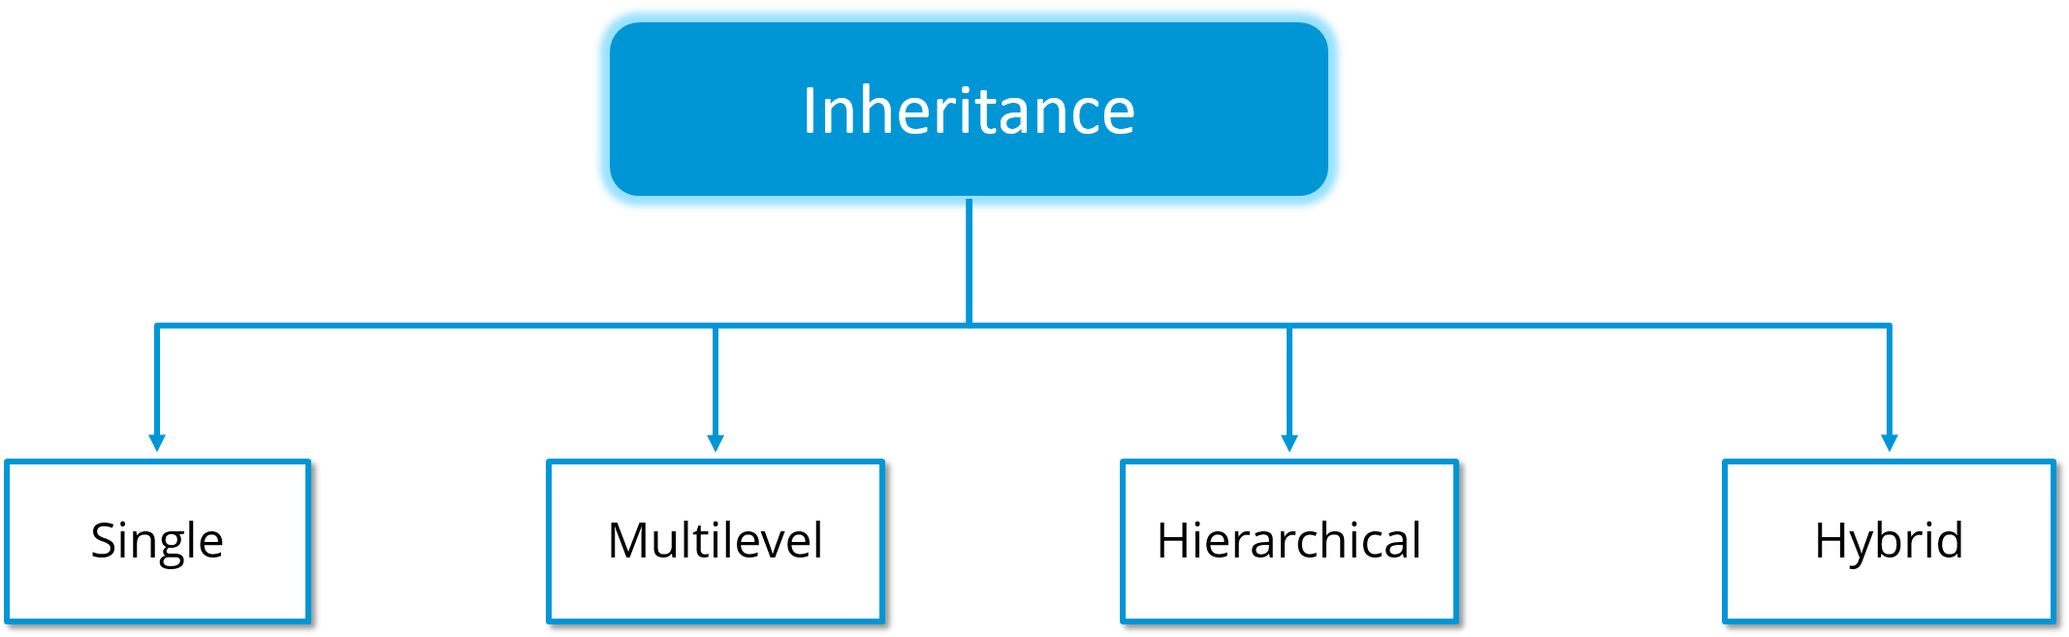
Types of Inheritance
There are four Inheritance types.

Slide 71
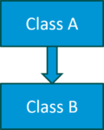
Single Inheritance
In single inheritance, one class inherits properties from another class.
It enables a derived class to inherit properties and methods from a single parent class.
Below, class A is a parent class, and class B is a child class that inherits the parent class' properties and methods.
Class A {
---
}
Class B extends A {
---
}

Slide 72
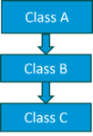
Multilevel Inheritance
It occurs when a derived class is the parent class for another class, i.e. a class having more than one parent class but at different levels.
Below, class B inherits properties and methods from class A. In turn, class C inherits properties from class B. Class A is class B’s parent class, and class B is class C’s parent class. So, class C inherits the properties and methods from class A through class B.
Class A {
---
}
Class B extends A {
---
}
Class C extends B {
---
}

Slide 73
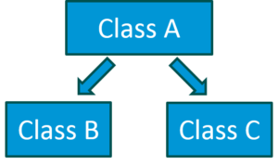
Hierarchical Inheritance
It occurs when a class has more than one child class (subclasses), in other words, multiple child classes have the same parent class.
Below, classes B and C are child classes inheriting from class A.
Class A {
---
}
Class B extends A {
---
}
Class C extends A {
---
}

Slide 74
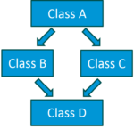
Hybrid Inheritance
Hybrid inheritance is the combination of multiple inheritance and multilevel inheritance.
Since multiple inheritance is not supported in Java, as it leads to ambiguity, a workaround is to use interfaces.
To the right, class A is the parent class of classes B and C, whereas classes B and C are the parent classes of D.

Slide 75
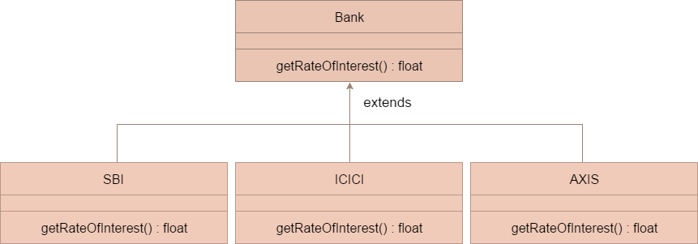
Overriding in Java
It occurs when a subclass (child class) has a method with the same signature (same name and parameters) as in the parent class.

Slide 76
The super keyword
The super keyword is a reference variable used to refer to the immediate parent class.
Usage of the super keyword.
super can be used to refer to the immediate parent class instance.
super can be used to invoke a method from the immediate parent class.
super() can be used to invoke immediate parent class constructor.
‹#›

Slide 77
The super keyword
super is used to refer the immediate parent class instance variable.
class TestSuper {
public static void main(String args[]){
Dog d = new Dog();
d.printColor();
}
}
class Animal {
String color = "white";
}
class Dog extends Animal {
String color = "black";
void printColor() {
System.out.println(color);/* prints Dog class color */
System.out.println(super.color);/* prints Animal class color */
}
}
‹#›

Slide 78
The super keyword
super can be used to invoke the parent class’ method.
class Animal {
void eat() {
System.out.println("eating...");
}
}
class Dog extends Animal {
void eat(){
System.out.println("eating bread...");
}
void work() {
super.eat();
eat();
}
}
class TestSuper {
public static void main(String args[]) {
Dog d = new Dog();
d.work();
}
}
‹#›

Slide 79
The super keyword
super() is used to invoke the parent class constructor.
class TestSuper {
public static void main(String args[]){
Dog d = new Dog();
}
}
class Animal {
Animal() {
System.out.println("Animal created");
}
}
class Dog extends Animal {
Dog() {
super();
System.out.println("Dog created");
}
}
‹#›

Slide 80
The final keyword
The final keyword is used to restrict the user. It can be used on variables, methods and classes.
variables
methods
classes
‹#›

Slide 81
final variables
The final variable value cannot be changed. It must be constant.
class Bike {
final int speedlimit = 90; /* final variable */
void run(){
speedlimit = 400;
}
public static void main(String args[]) {
Bike obj = new Bike();
obj.run();
}
}
Output: Compilation Error
‹#›

Slide 82
final methods
Final methods cannot be overridden.
class Bike {
final void run() {
System.out.println("running");
}
}
class Honda extends Bike {
void run() {
System.out.println("running safely with 100kmph");
}
public static void main(String args[]) {
Honda honda = new Honda();
honda.run();
}
}
Output: Compilation Error
‹#›

Slide 83
final classes
Final classes cannot be extended.
final class Bike {
}
class Honda1 extends Bike {
void run() {
System.out.println("running safely with 100kmph");
}
public static void main(String args[]) {
Honda honda = new Honda();
honda.run();
}
}
Output:Compilation Error
‹#›

Slide 84
Java Interface
An Interface is a contract that must be fulfilled by the Class that implements the Interface.
Interface variables are static final by default (constants).
An Interface contains abstract methods.
An abstract method is a method that is declared but not defined because it doesn’t have a body.
Interface methods are public abstract by default.
Interfaces support multiple inheritance.
Interfaces are created by using the Interface keyword.
‹#›

Slide 85
Java Interface
In Java, a Class extends another Class, an Interface can also extend another Interface, but a Class implements an interface.
An Interface can refer to an Object, but it cannot be instantiated.
class
interface
interface
extends
implements
extends
class
class
interface
‹#›

Slide 86
Java Interface
class
interface
interface
extends
implements
extends
class
class
interface
class A {
//variables
//methods
}
class B extends A {
//variables
//methods
}
interface I{
//abstract methods
//final static variables
}
class B implements I {
//method implementation;
}
interface I1 {
// abstract methods
// final static variables
}
Interface I2 extends I1 {
// abstract methods
// final static variables
}
class B implements I2 {
// methods implementation;
}

Slide 87
Multiple Inheritance with Interfaces
interface
interface
interface
interface
extends
implements
interface
implements
class
class
class A implements I1, I2 {
//Implement all the methods from I1 & I2
}
interface I extends I1, I2 {
/* final static variables */
/* abstract methods */
}
class A implements I {
/* Implement all the methods from */ I
}

Slide 88
Java Packages
A Java package is a like a folder that groups classes, interfaces and sub-packages.
A package can be categorized into two types:
Built-in package
User-defined package
There are many built-in packages such as java.lang, java.awt, javax.swing, java.net, java.io, java.util, java.sql to mention a few.
‹#›

Slide 89
Access a package from outside
There are two ways to access a package from outside the package.
import package.*; /* Import all elements from the package */
import package.classname; /* Import a specific class from the package */
‹#›

Slide 90
Access Modifiers
The access modifiers specify the accessibility (scope) of variables, methods, constructors and classes.
There are four types of access modifiers in Java:
private
default
protected
public
‹#›

Slide 91
The private access modifier
The private access modifier makes variables, constructors and methods accessible within the class only.
class A{
private int data = 40;
private void msg(){
System.out.println("Hello java");
}
}
public class Simple{
public static void main(String args[]){
A obj = new A();
System.out.println(obj.data); /* Compile Time Error */
obj.msg(); /* Compile Time Error */
}
}
‹#›

Slide 92
The default access modifier
The default access modifier makes variables, constructors, methods and classes accessible within the package only.
The default access modifier, as the name suggests, is the default modifier when no access modifier is specified.
package pack;
class A{
void msg(){
System.out.println("Hello");
}
}
package mypack;
import pack.*;
class B{
public static void main(String args[]){
A obj = new A();/* Compile Time Error */
obj.msg(); /* Compile Time Error */
}
}
Class A’s and its method msg() scope is default in the example above, so they cannot be accessed from outside the package.
‹#›

Slide 93
The protected access modifier
The protected access modifier makes variables, constructors and methods accessible within the package (like the default modifier does) and from outside the package through inheritance only.
The protected access modifier cannot be used on classes.
package pack;
public class A {
protected void msg() {
System.out.println("Hello");
}
}
package mypack;
import pack.*;
class B extends A {
public static void main(String args[]) {
B obj = new B();
obj.msg();
}
}
‹#›

Slide 94
The public access modifier
The public access modifier makes variables, methods and classes accessible from everywhere. It has the widest scope among all other modifiers.
package pack;
public class A{
public void msg(){
System.out.println("Hello");
}
}
package mypack;
import pack.*;
class B{
public static void main(String args[]){
A obj = new A();
obj.msg();
}
}
‹#›

Slide 95
Access modifiers
Access Modifier | within class | within package | outside package by subclass only | outside package
Private | Y | N | N | N
Default | Y | Y | N | N
Protected | Y | Y | Y | N
Public | Y | Y | Y | Y
‹#›

Slide 96

Any Questions

